Slide 1
WATER AND THE POTENTIAL FOR SOCIAL INSTABILITY: LIVELIHOOD, MIGRATION AND THE BUILDING OF SOCIETY
Dr.Marcus Moench

Slide 2
Nearly 70% of world’s freshwater withdrawal is utilized for irrigation.
This paper focuses on ground water and its importance for irrigation in semi arid and arid regions.
Ground water is the preferred form of irrigation.
Cost effective.
Hassle free and not time consuming.
Resistant to climatic changes.
‘Silent Revolution’(SR) in the last half century.
SR has other positive effects as well – education, alternative professions, transition to an urban lifestyle.
Negative effects - ‘Colossal Anarchy’.

Slide 3
Water resources and stability
Lack of access to water leads to : Forced migrations ; Unemployment, Unstable populations.
It creates : Urban slums; Rural poor.
This is a fertile ground for communal discontent, community tensions and identity politics.
Issues around water are mostly internal rather than external.
Water and conflict linked through poverty ,migration, settlements and food security.

Slide 4
1. Water to Poverty
Water depletion increases rural impoverishment.
Poor - Have no other skill sets, alternative sources of income is absent.

Slide 5
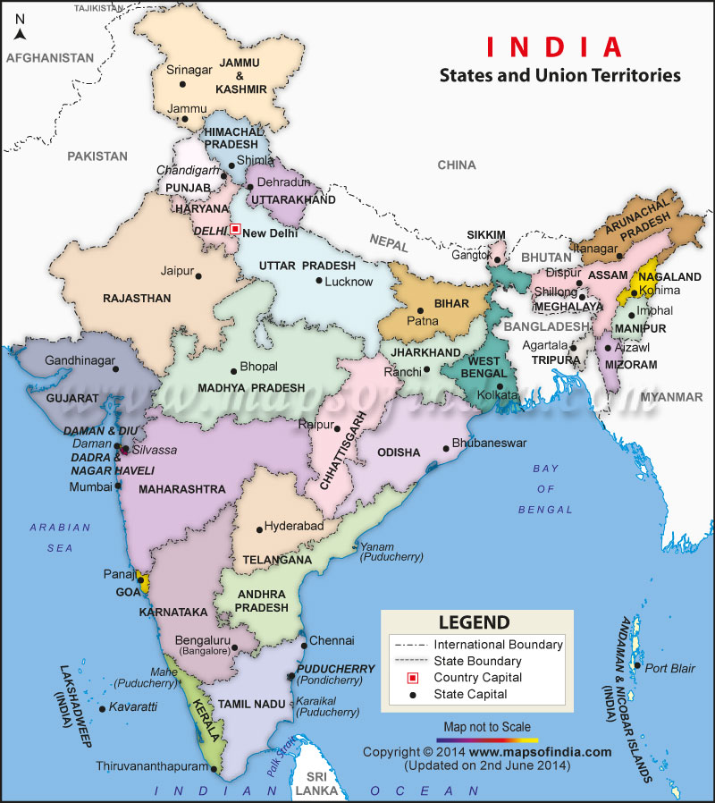
2. Poverty to migration
Eg: Case of Satlasna Taluk,Gujarat,India.
Decline in water levels has led to investing in other forms of livelihood.
Transition is abrupt during drought periods.
Rich farmers invest in drilling wells. Their savings are disappearing.
Short term migrations during drought are alright, but long term indicates a decline in regional economic prospects.

Slide 6
3. Migration to Social Instability
Drought depletes the assets of small farmers.
Corruption, the decline of civil institutions, communal politics.
Demands for falsification of data, ‘political sensitivity of data’, manipulation of funds to rural areas.
Social tensions between families and between communities.
Perceived injustice and further instability.

Slide 7
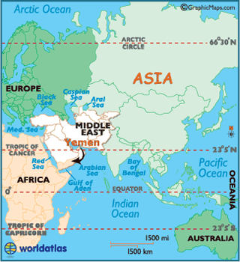
Water and Security
Water is a weapon of peace.
Improved irrigation facilities will tie down populations, gives them stability.
Food security and reliability.
De-populated rural areas are a haven for anti-social elements.
Eg: Saudi Arabia. (Risk- Yemen)
Somalia, Eritrea

Slide 8
In conclusion
Education
Economic Diversification
Migration and Urbanization
Adaptive civil society institutions.
The fundamental challenges for security depends on how peacefully these changes occur.

Slide 9
References:
Moench,M.,(2002), “Water and the Potential for Social Instability: Livelihoods, Migration and the Building of Society”, Natural Resource Forum 26, 195-204.
Llamas,M.R.,Santos,P.M.,(2005), “Intensive Groundwater Use: Silent Revolution and Potential Source of Social Conflicts.”,Journal of Water Resources Planning and Management (October 2005), 337-341.

